Slide 1

SQL Capstone Project Overview
Data Science
Analysis of sales data of Amazon
Dhilip Prakash S

Slide 2
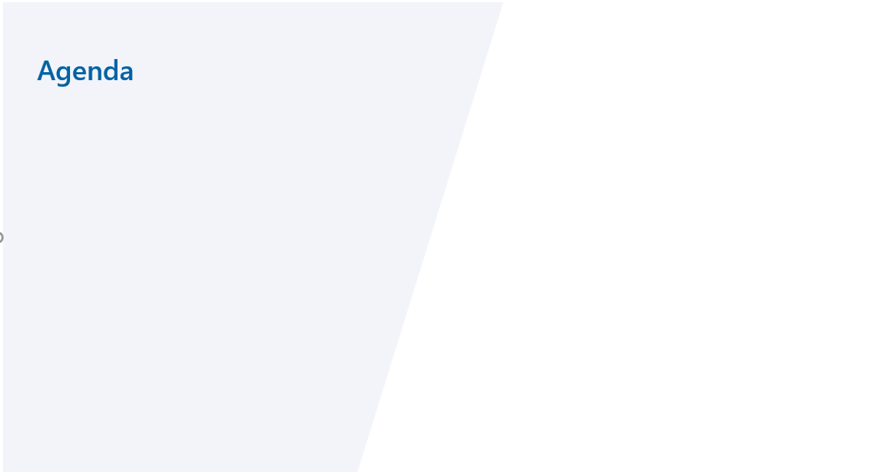
1. Purpose:
To understand the different factors that affect sales of the different branches.
2. About Data:
This dataset contains sales transactions from three different branches of Amazon, respectively located in Mandalay, Yangon and Naypyitaw. The data contains 17 columns and 1000 rows:
3. Create a Data base
4. Import the dataset using wizard or create a table ‘Sales’ and insert the values by using the insert script
5. Add New Columns
6. Analysis List
Product Analysis:
Sales Analysis
Customer Analysis

Slide 3
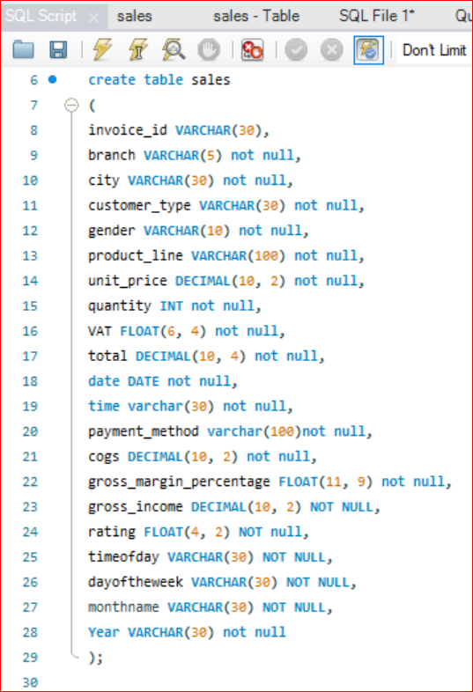

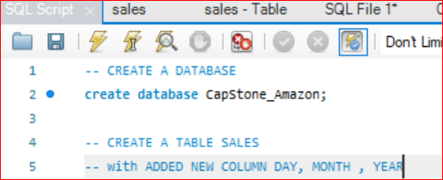

Create a Data base,
STEP - 1 CREATE A DATABASE
CREATE DATABASE CapStone_Amazon;
STEP - 2 CREATE A TABLE SALES

Slide 4
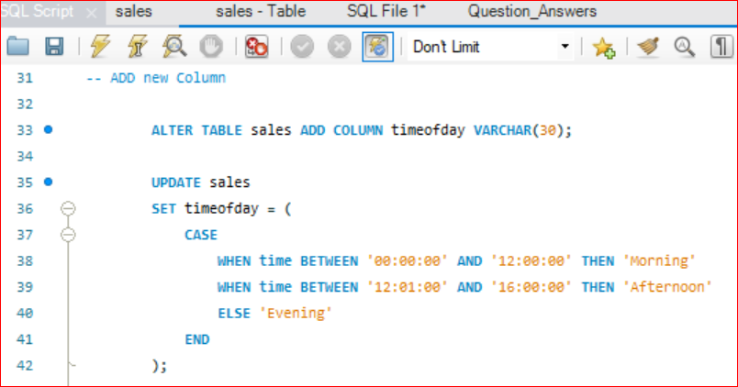
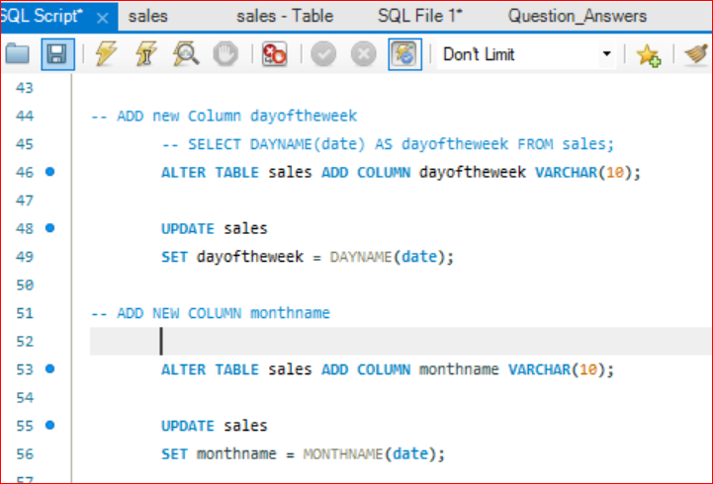
STEP - 2 CREATE A TABLE SALES
-- with ADDED NEW COLUMN DAY, MONTH , TimeOfDay

Slide 5
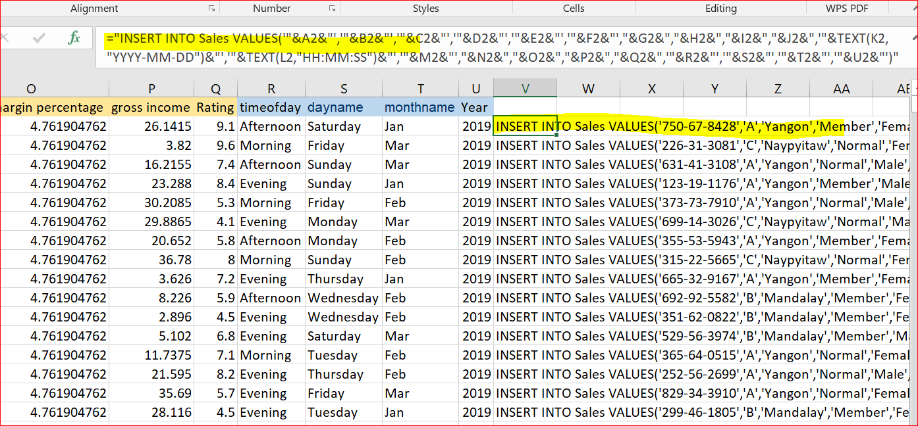
STEP – 3 Import data or Generate Insert Script
3.1 Using the Import Wizard, to import the data source file to MySQL
3.2 Generate a Insert Script to insert the values to the Table
3.2 Convert the excel data into a insert script

Slide 6
Analysis List
Product Analysis
Sales Analysis
Customer Analysis

Slide 7
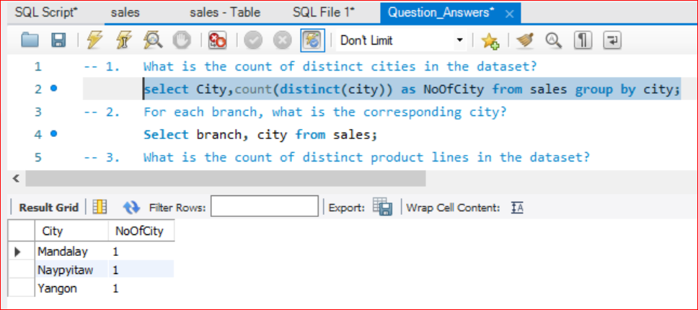
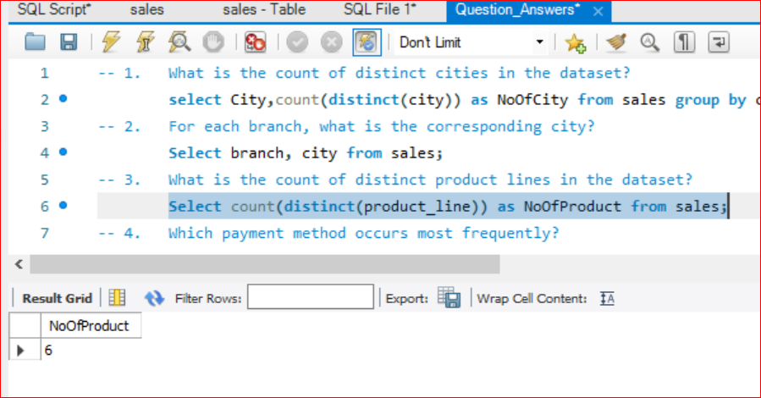
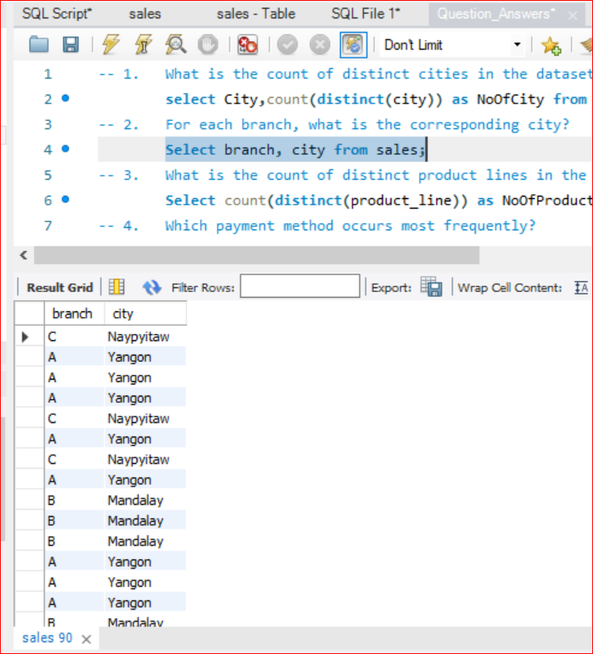
Sales Analysis
1. What is the count of distinct cities in the dataset?
2. For each branch, what is the corresponding city?
3. What is the count of distinct product lines in the dataset?
Q1
Q3
Q2

Slide 8
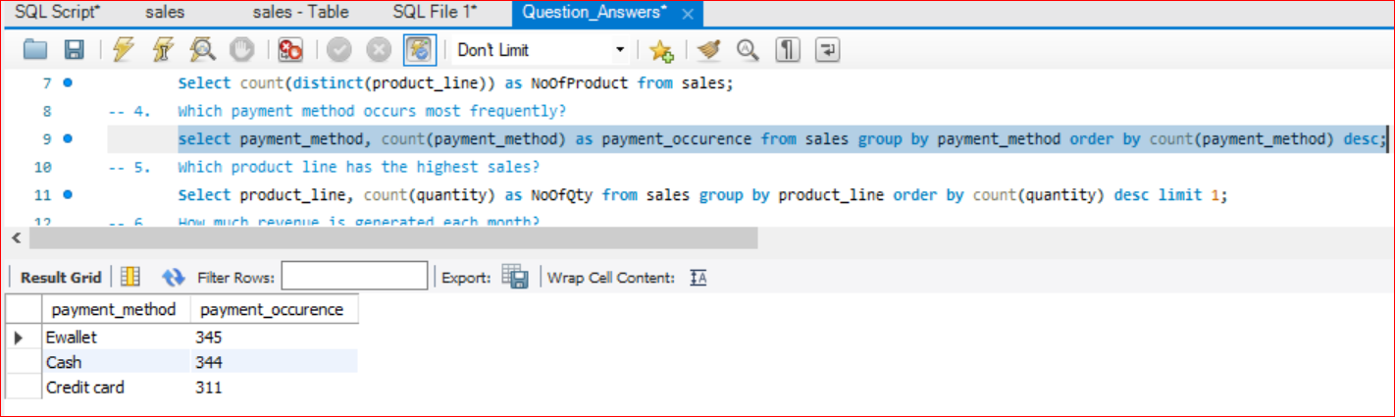
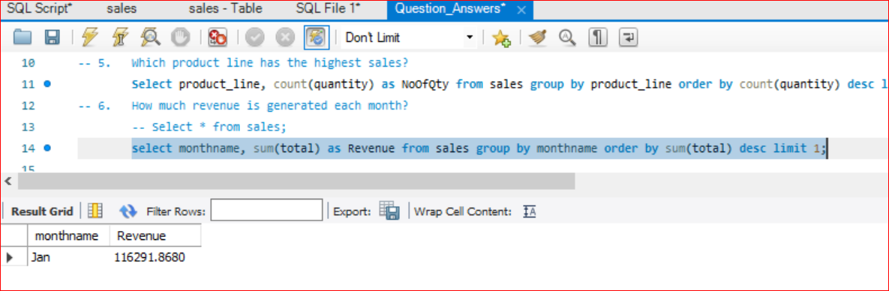
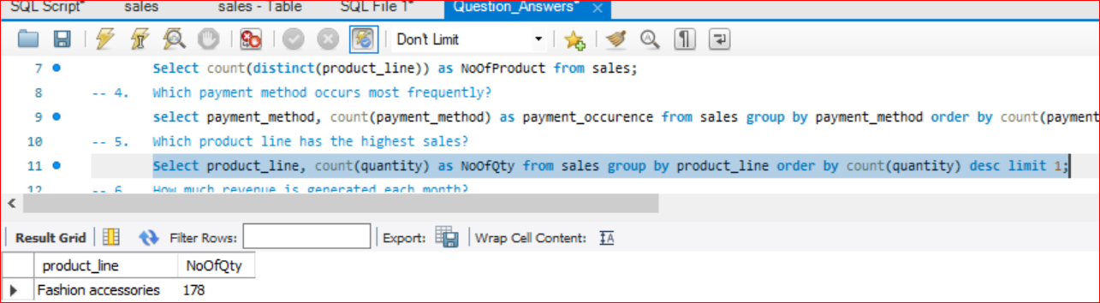
Sales Analysis
4. Which payment method occurs most frequently?
5. Which product line has the highest sales?
6. How much revenue is generated each month?
Q4
Q6
Q5

Slide 9
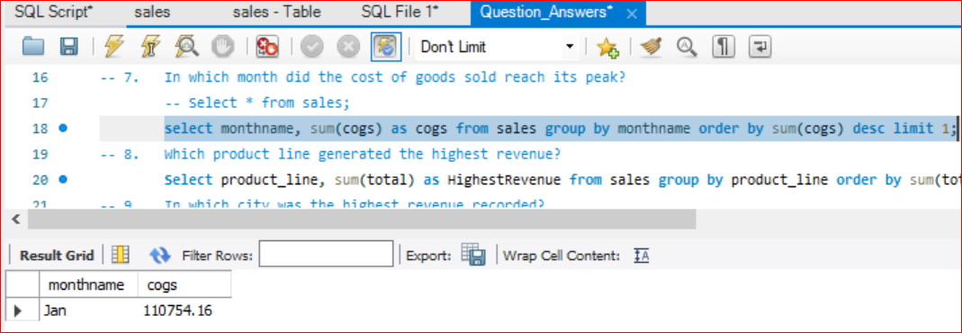
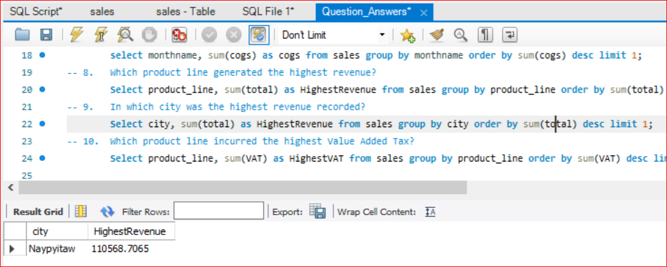
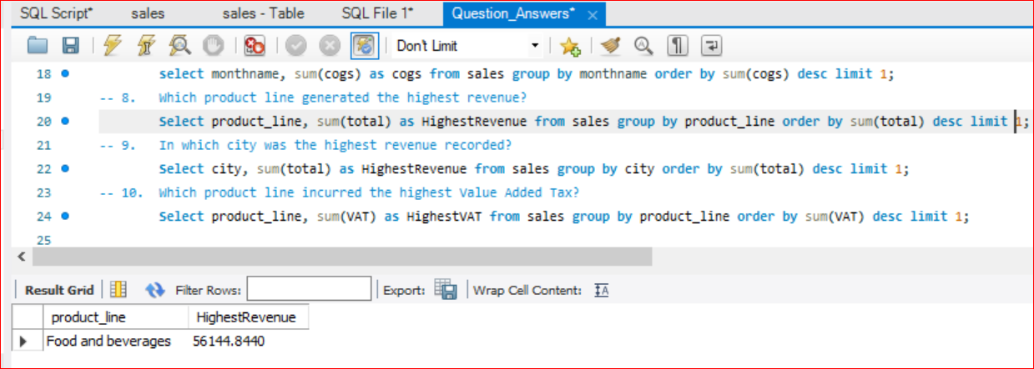
Sales Analysis
7. In which month did the cost of goods sold reach its peak?
8. Which product line generated the highest revenue?
9. In which city was the highest revenue recorded?
Q7
Q9
Q8

Slide 10
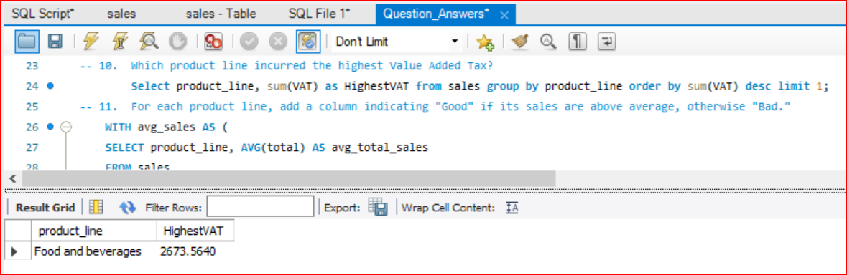
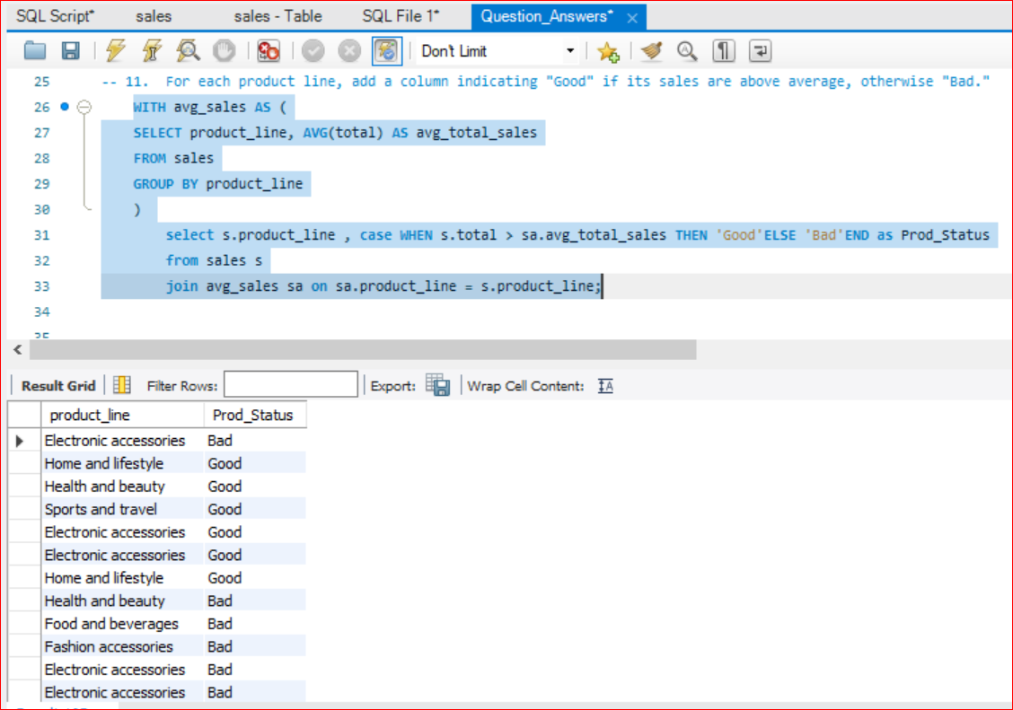
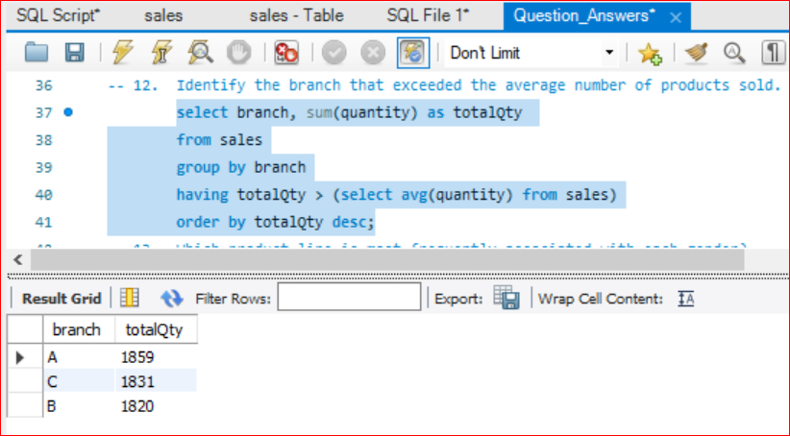
II. Product Analysis
10. Which product line incurred the highest Value Added Tax?
11. For each product line, add a column indicating "Good" if its sales are above average, otherwise "Bad."
12. Identify the branch that exceeded the average number of products sold.
Q10
Q11
Q12

Slide 11
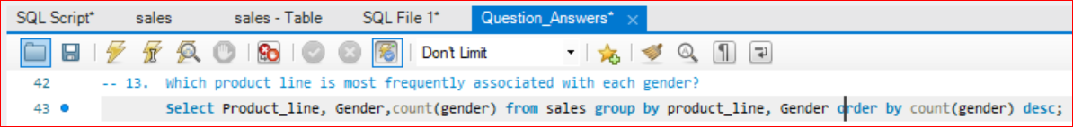
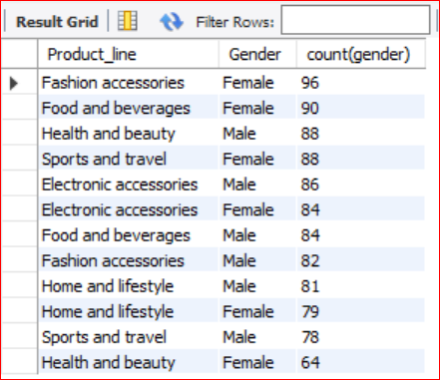
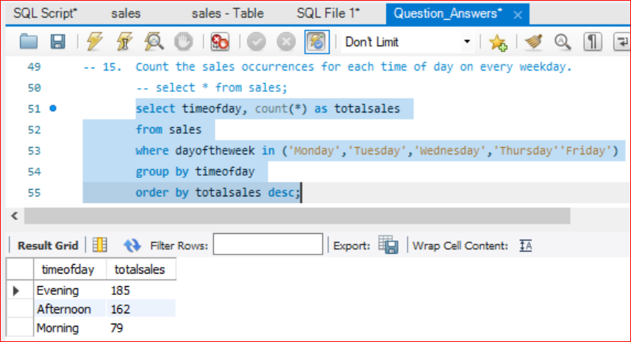
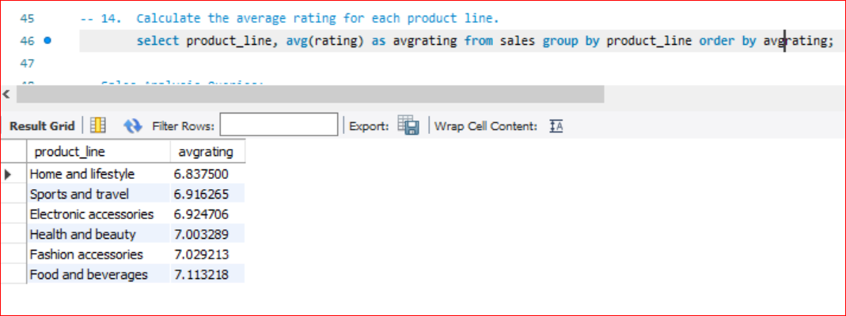
II. Product Analysis
13. Which product line is most frequently associated with each gender?
14. Calculate the average rating for each product line.
15. Count the sales occurrences for each time of day on every weekday.
Q13
Q14
Q15

Slide 12
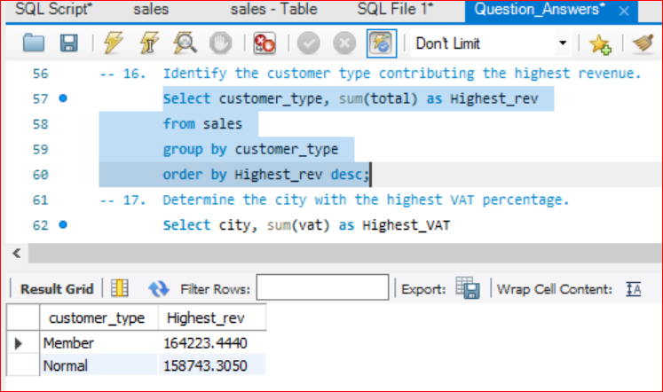
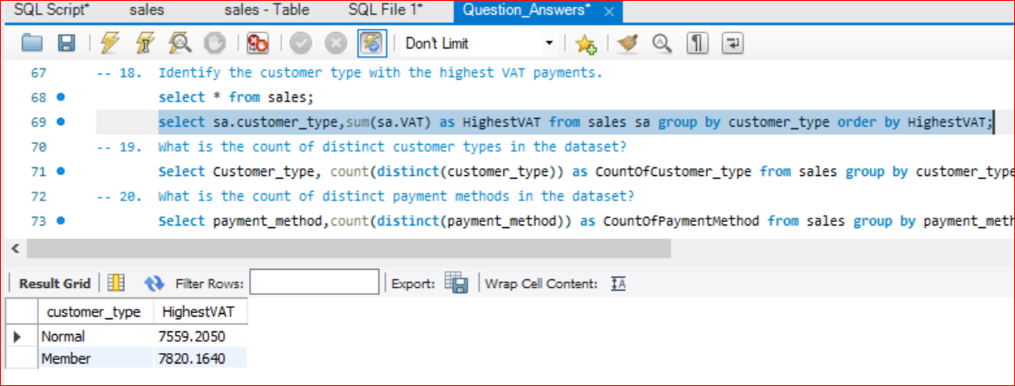
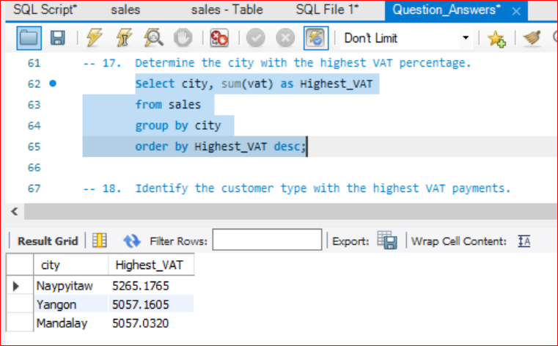
III. Customer Analysis
16. Identify the customer type contributing the highest revenue.
17. Determine the city with the highest VAT percentage.
18. Identify the customer type with the highest VAT payments
Q16
Q18
Q17

Slide 13
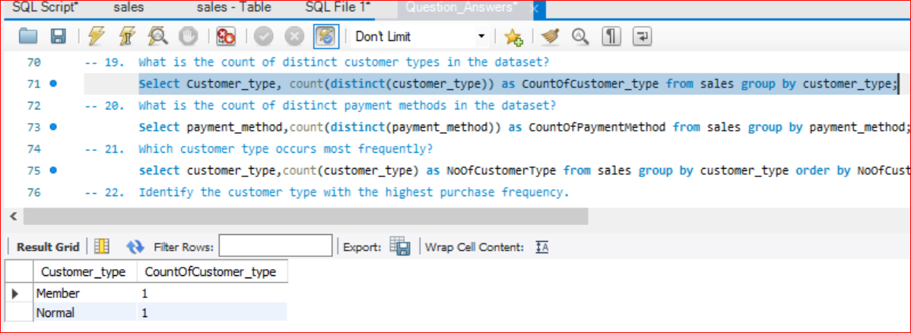
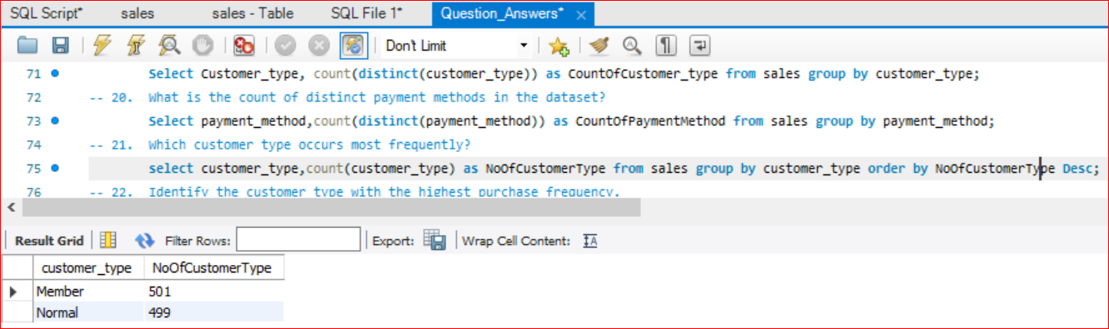
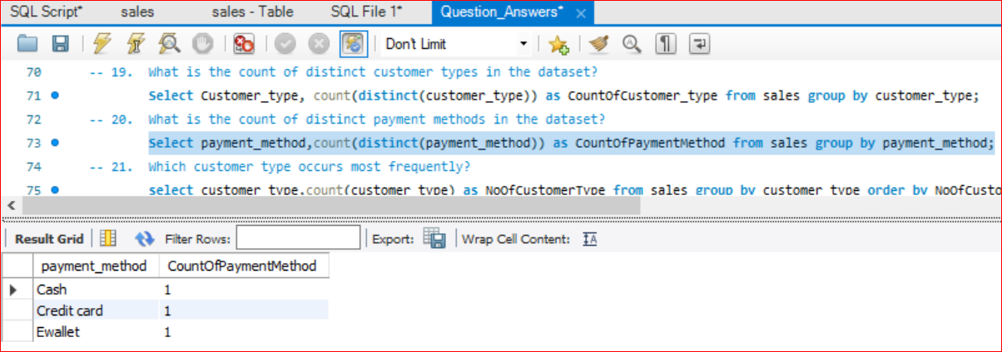
III. Customer Analysis
19. What is the count of distinct customer types in the dataset?
20. What is the count of distinct payment methods in the dataset?
21. Which customer type occurs most frequently?
Q19
Q21
Q20

Slide 14
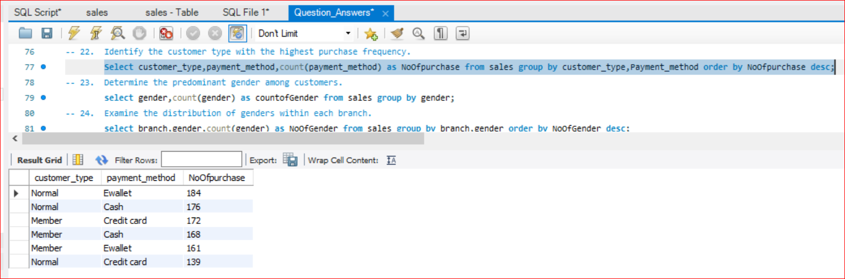
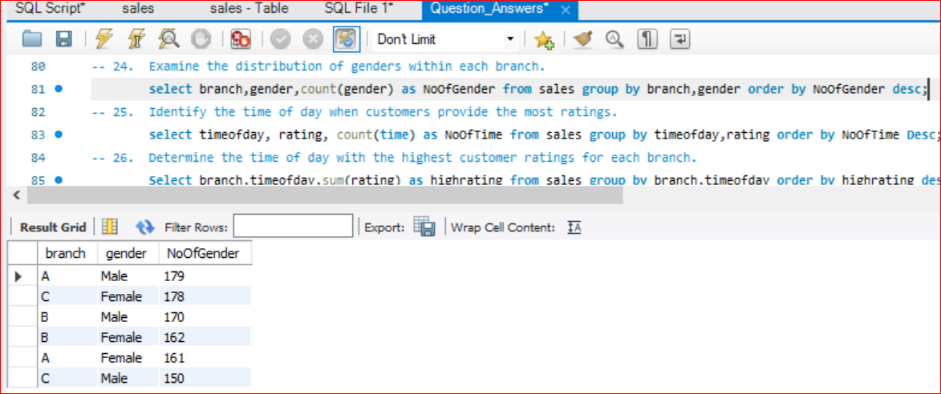
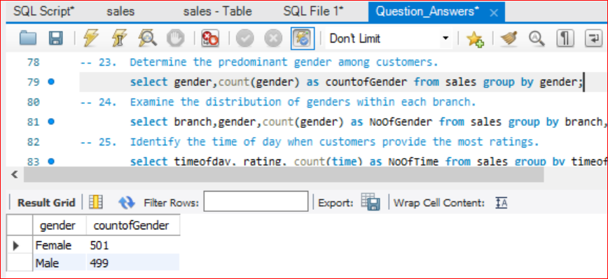
III. Customer Analysis
22. Identify the customer type with the highest purchase frequency.
23. Determine the predominant gender among customers.
24. Examine the distribution of genders within each branch.
Q22
Q24
Q23

Slide 15
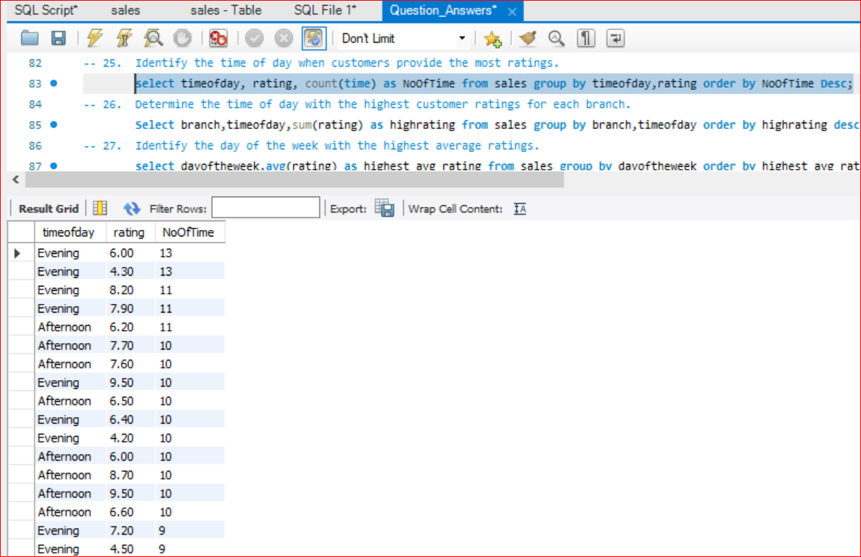
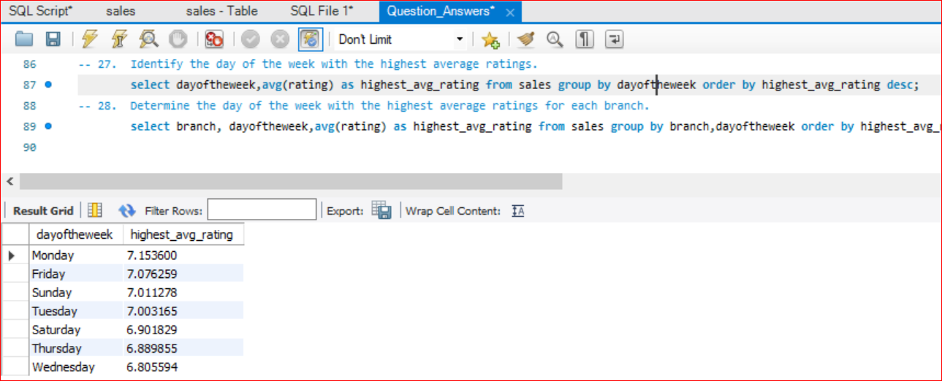
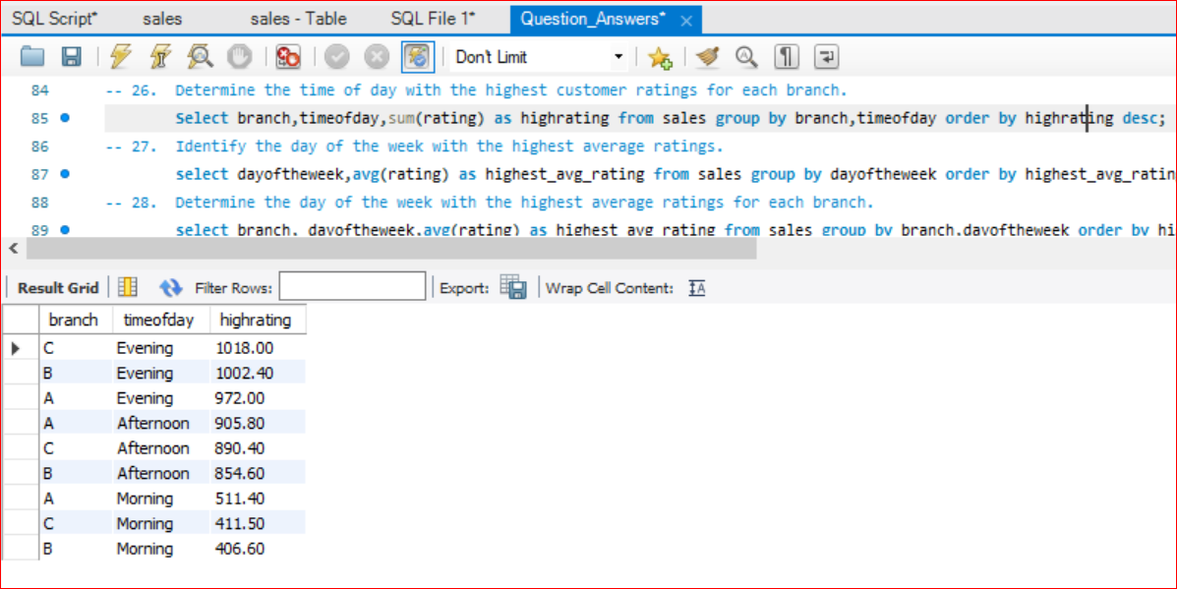
III. Customer Analysis
25. Identify the time of day when customers provide the most ratings.
26. Determine the time of day with the highest customer ratings for each branch.
27. Identify the day of the week with the highest average ratings.
Q25
Q26
Q27

Slide 16
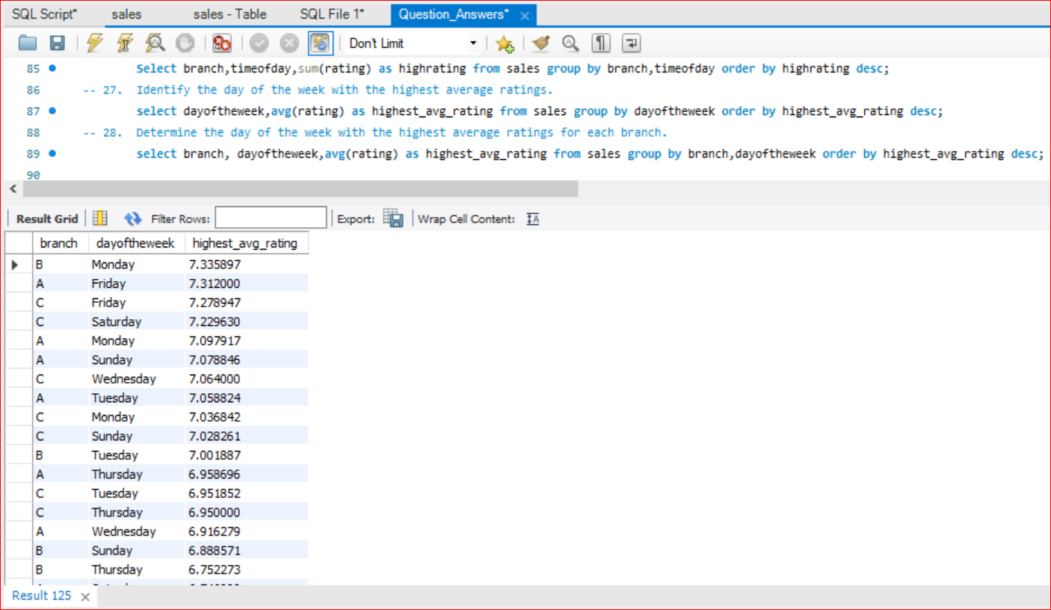
III. Customer Analysis
28. Determine the day of the week with the highest average ratings for each branch.
Q25
Q28

Slide 17
Thank You

